Slide 1
Decoding the Black Box: Evaluating XAI with Machine Learning for Prediction Explanation
Decoding the Black Box: Evaluating XAI with Machine Learning for Prediction Explanation
DS 303 Course Project | Instructor:- Prof. Biplab Banerjee
Karthikeyan J (21d170021)
Kartik Sood (21d170022)
Vishesh Kamani (21d170046)
Akash Sansugu Palaniswami (21d171001)

Slide 2
Contents
Introduction to XAI Explanation | 3
The Importance of XAI Evaluation | 4
Models (Models Used and Comparison) | 5
SHAP and LIME (Introduction) | 7
Datasets | 9
SHAP and LIME (Results) | 10
Evaluation Framework | 13
Visual Explanation | 14
Results and Conclusion | 15
References and Contribution of Team Members | 17

Slide 3
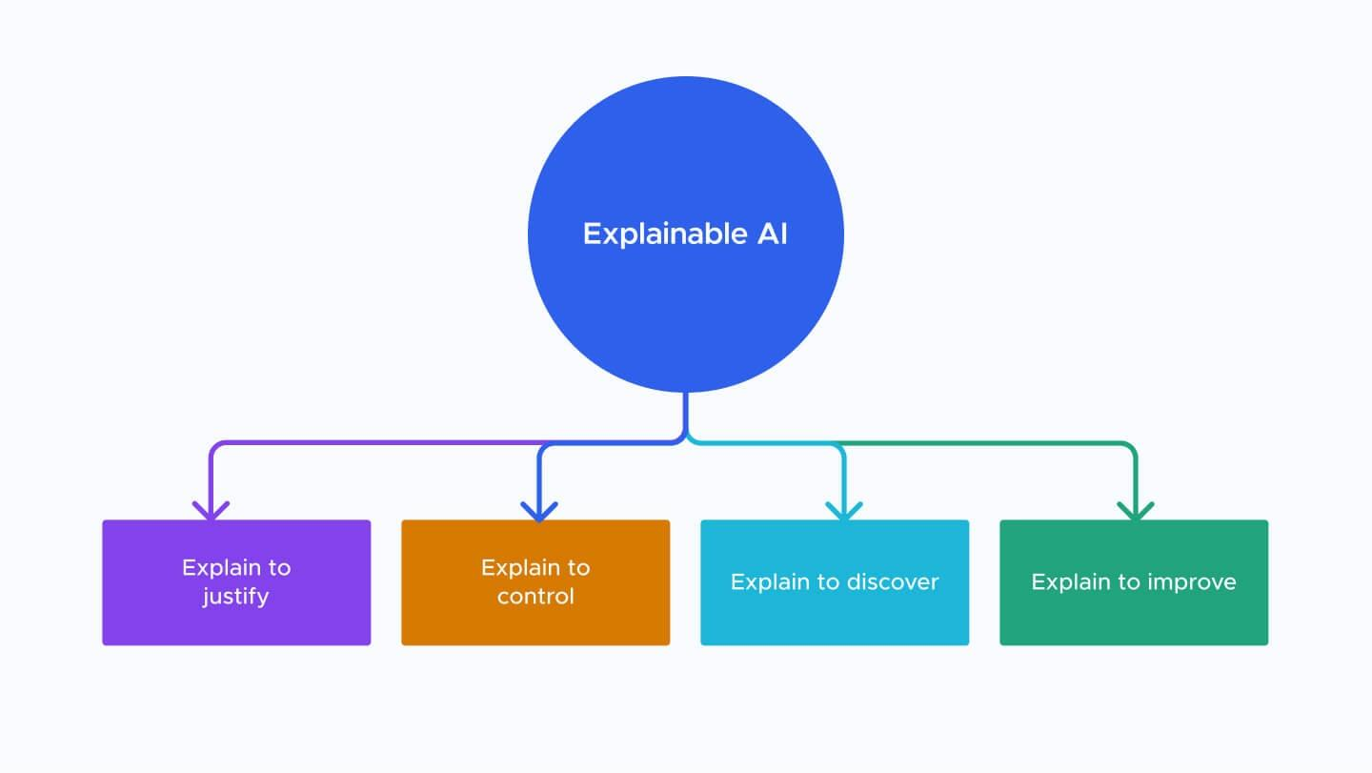
Introduction to XAI Explanation
Machine learning models have become increasingly complex, and their decision-making processes are often opaque. This has led to the development of XAI (Explainable AI) techniques that aim to make these models more transparent and interpretable.
However, evaluating the effectiveness of XAI techniques is a challenging task. In this presentation, we will discuss a machine learning project focused on XAI evaluation.

Slide 4
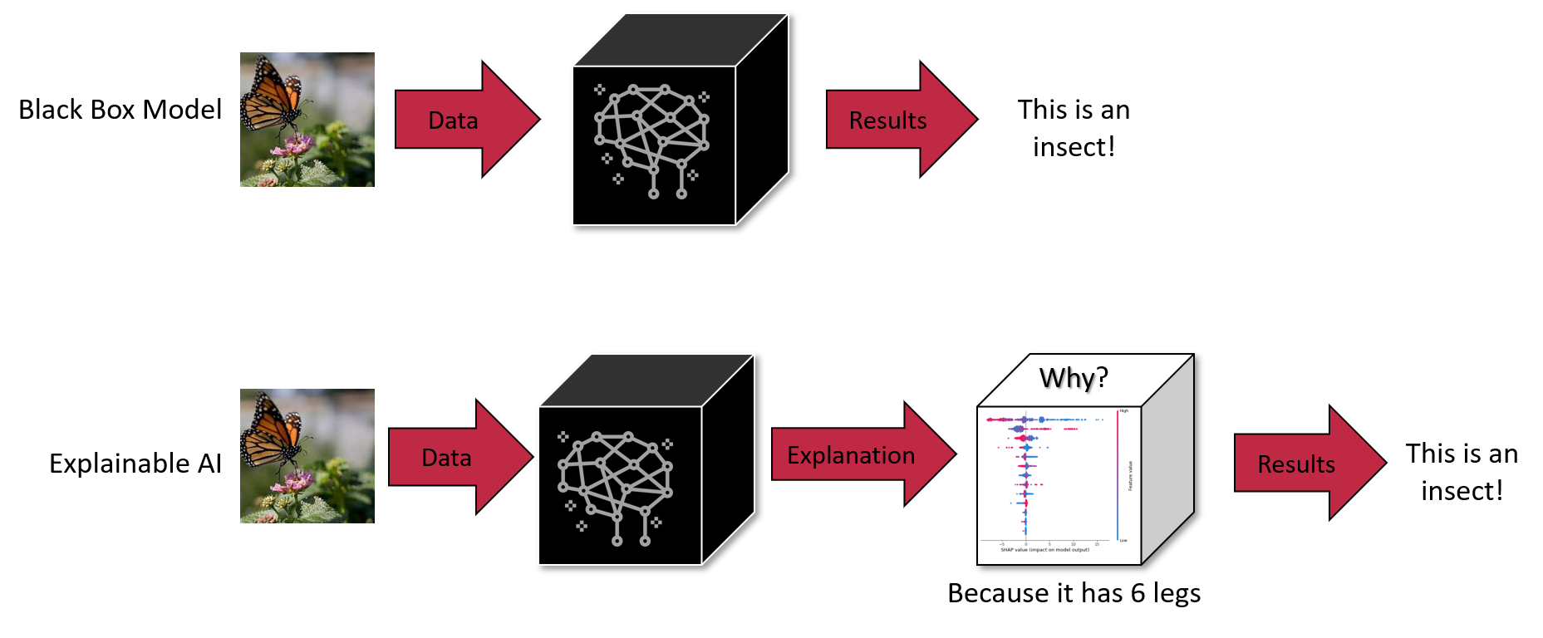
The Importance of XAI Evaluation
XAI evaluation is crucial for ensuring the transparency and reliability of machine learning models. It allows us to assess the accuracy and consistency of the explanations provided by these models.
Moreover, XAI evaluation can help identify potential biases or errors in the decision-making process of machine learning models, which can be used to improve their performance and reduce their impact on society.

Slide 5
Models Used
White Box Models Used-
Linear Regression
Decision Tree
Black Box Models Used-
Random Forest
Random Forest models can be highly complex and may contain hundreds or thousands of decision trees, making it difficult to understand the overall decision-making process of the model
LightGBM
The internal workings of each individual decision tree are complex and difficult to understand, and the overall model can be highly intricate, with many different trees and combinations of features.

Slide 6
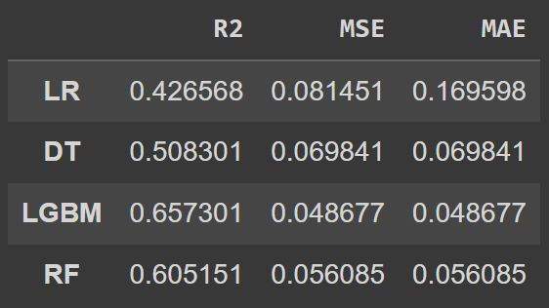
COMPARING THE MODELS
So we begin off with first proving that in comparison to traditional white-box models, the black box models such as neural networks and ensemble models have absolute advantage in prediction. So to prove this, we run a simple metric test for the following models
Linear Regression (LR) and Decision Tree (DT) for traditional models
Ensemble Models such as LightGBM (LGBM) and Random Forest (RF)
﻿
Now given the better metrics, the black-box models are much more prefered, but there is the issue of non-explainability, so we explore SHAP and LIME as methods to improve the explainability of the black-box models.

Slide 7
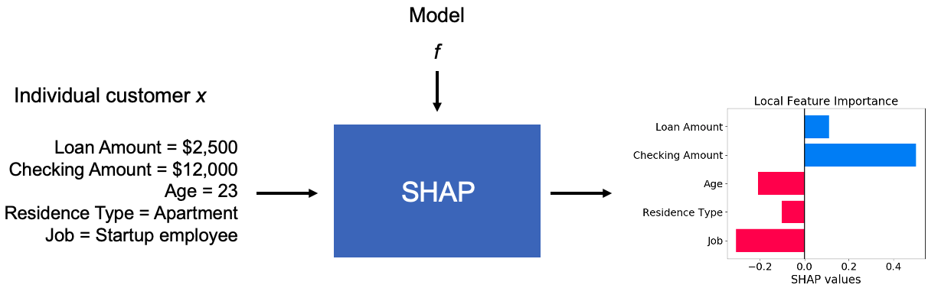
SHAP
SHAP (SHapley Additive exPlanations) is a framework for interpreting the output of machine learning models.
The SHAP approach is based on the Shapley value, a concept from cooperative game theory that assigns a fair distribution of payouts to each player in a coalition. In the context of machine learning, SHAP computes the contribution of each feature to the model prediction by considering all possible combinations of features and their outcomes
﻿

Slide 8
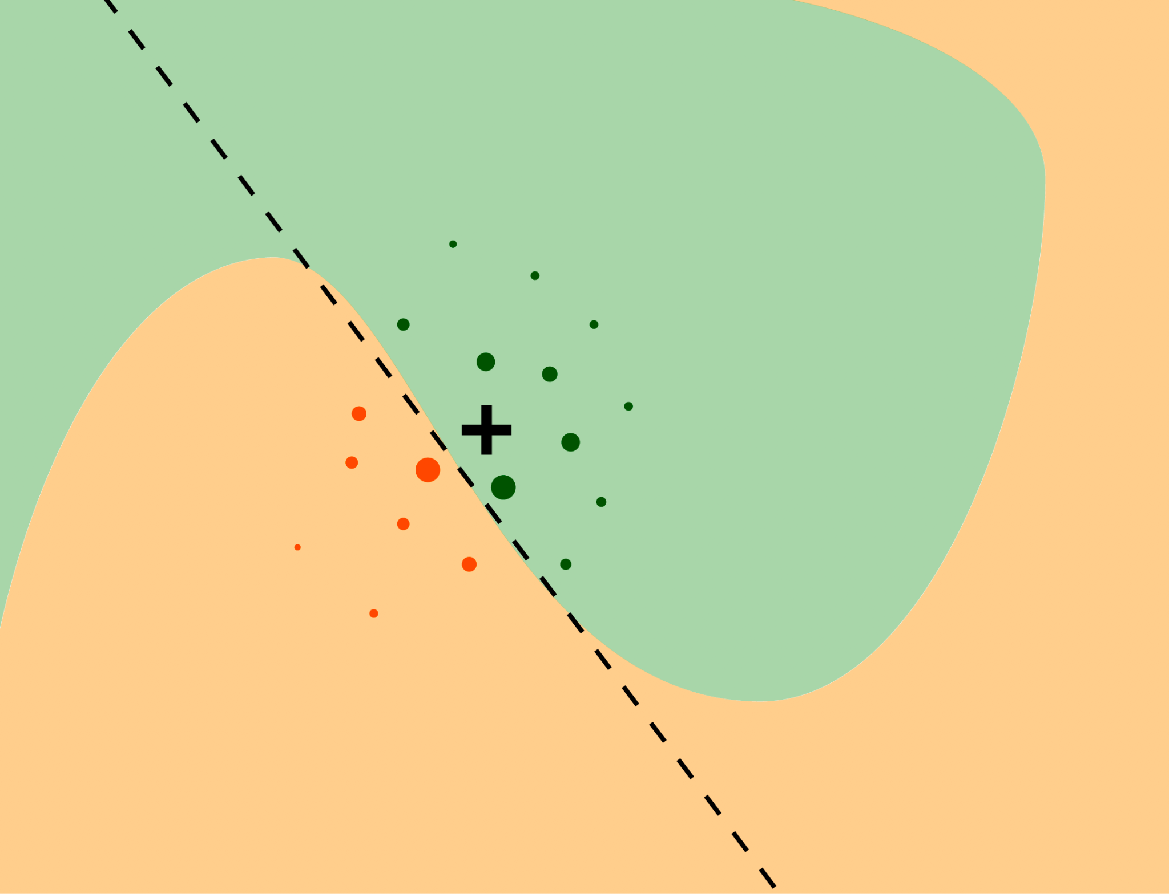
LIME
LIME (Local Interpretable Model-Agnostic Explanations) is an approach for explaining the predictions of machine learning models at the local level.
LIME works by generating a "local" interpretable model around the instance of interest, which is a simplified version of the original model that is easier to understand. This is achieved by perturbing the input data and observing how the output changes. The resulting interpretable model can then be used to identify the features that contributed most to the prediction for that instance.

Slide 9
DATASET IMPLEMENTED
We have used The Iranian Customer Churn Dataset which is a collection of customer information. The dataset contains information on approximately 7,000 customers.
It has 3150 examples with 15 features and a binary variable indicating whether or not the customer churned (i.e. cancelled their subscription).
All the features are numeric.
The dataset includes both demographic and usage data, which can provide valuable insights into the factors that contribute to customer churn. This can be particularly useful for XAI evaluation since we may want to identify the specific features that are driving the model's predictions.
The conference paper implemented the boston housing dataset in which prediction of house prices was carried out through regression models.

Slide 10
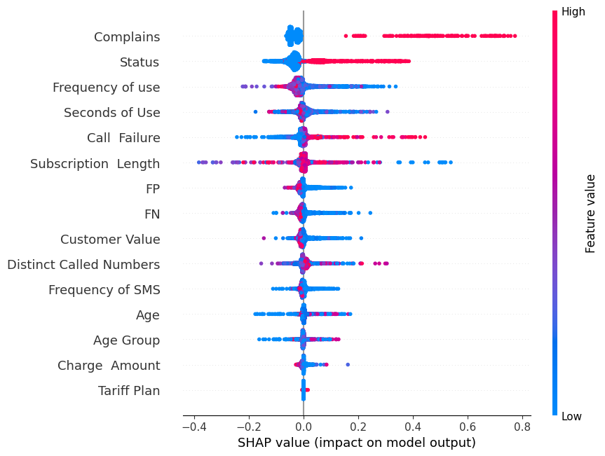
Shap Result
Now using these 2 frameworks separately, we can get different explanations of the black-box models, from which we can deduce the most significant parameters in the classification task. In the case of the SHAP framework, this was clearly indicated by the beeswarm plot of the Shap values which are significant of how important the feature is in the classification. On the right is the beeswarm plot for the Random Forest Model applied on the dataset.
﻿
Clearly, [Complains, Status and Frequency of use] seem to be very important features in this classification task.

Slide 11
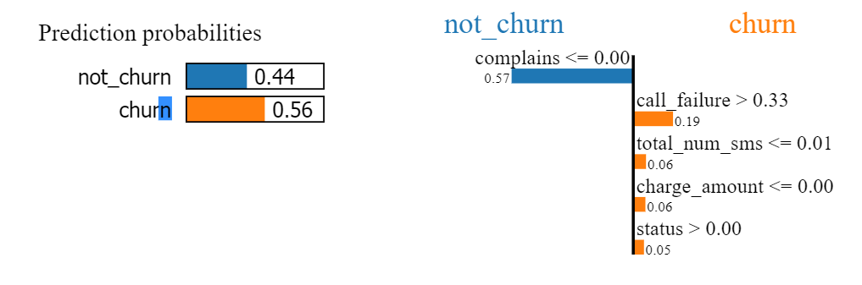
Lime Local Result Example
As we can see in the figure, this particular customer churns with a probability of 0.56.
We can see in the right figure that complains is a important feature but it is 0 in this case and hence it contributes largely to the not churn probability.
Call failure is the main reason here for the churn.

Slide 12
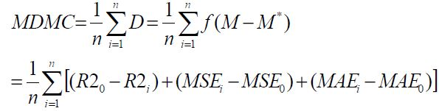
Mean Degree of Metrics Change
Now that we have determined a list of important parameters from the frameworks, we would have to evaluate to see if these results are good explanations of the model. So the evaluation framework we would be based on this idea: Deleting the large contribution features should result in a significant decrease in the accuracy of a model's prediction. So lets daw we get new metrics on modifying the data (R2*, MSE*, MAE*), now we can define a variable which measures the change in all these metrics (MDMC) which is defined as shown in the right. We normalise all the values before using them in the formula

Slide 13
EVALUATION FRAMEWORK
So we applied this evaluation framework on Random Forest Classifier model, with the dataset, and then used the SHAP and LIME framework to arrange the features based on how important they are perceived according to the framework.
Now as for a control, we also make a random order of the features.
Now we plot the loss metrics for the new dataset as we decrease the number of features according to the different feature arrangements from the framework and the random allotment.
[X-axis → Number of removed features]. We can clearly see that there is a great deal of loss of accuracy in the framework (SHAP and LIME) cases when compared to the random allotment.
We also observe that the graphs for MSE and MAE are identical as this is classification problem with all prediction and true values as 0 or 1.

Slide 14
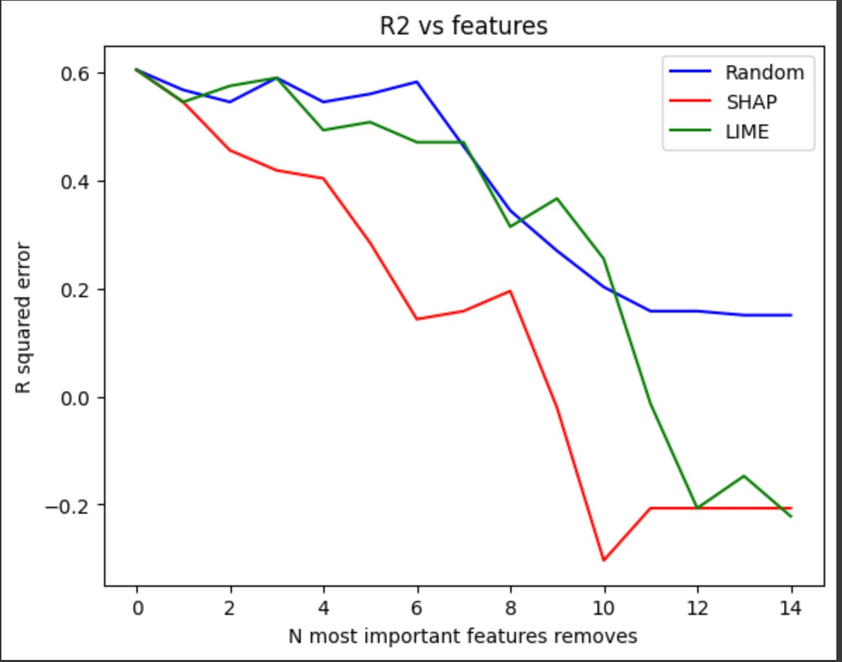
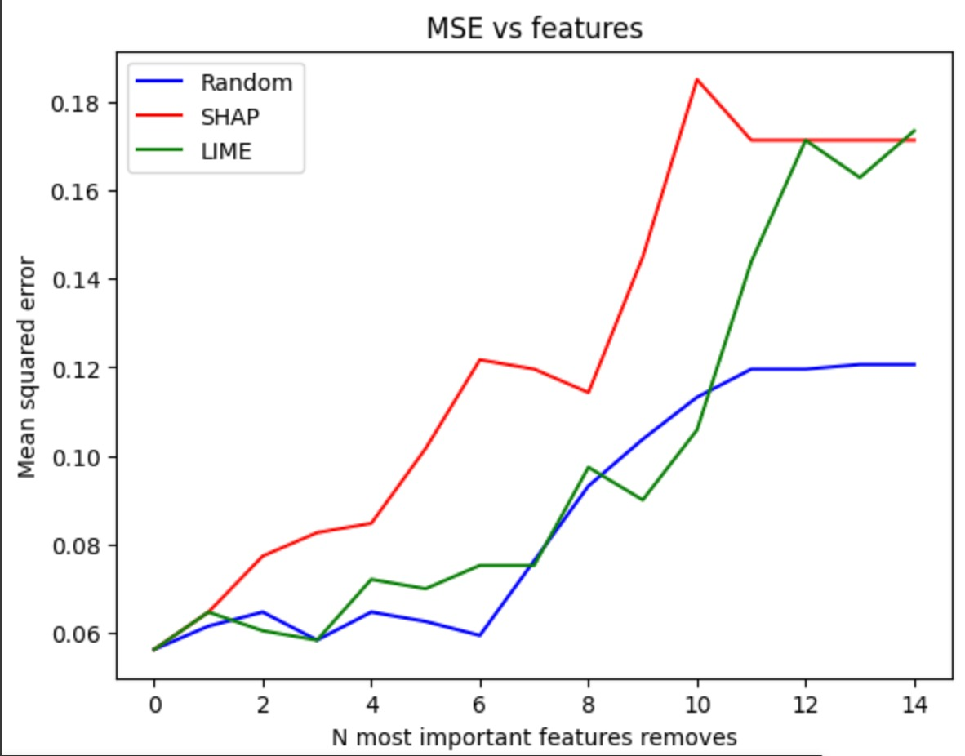
VISUAL EXPLANATION
RF

Slide 15
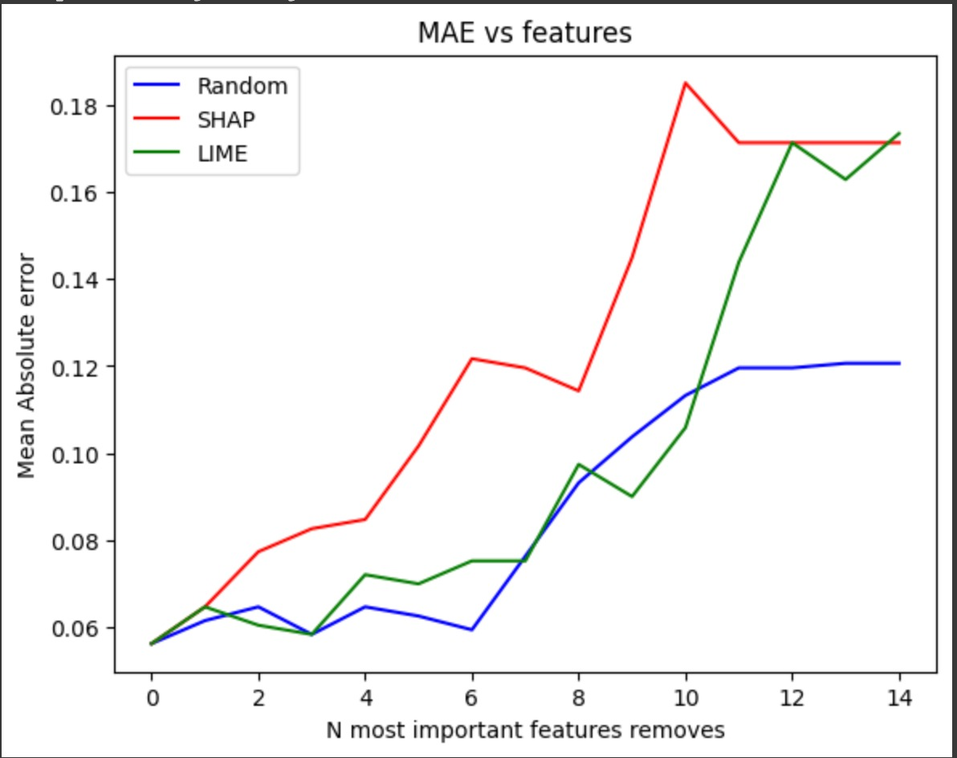
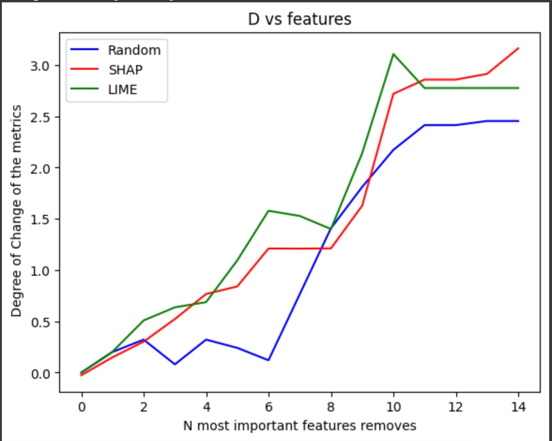
VISUAL EXPLANATION
RF

Slide 16
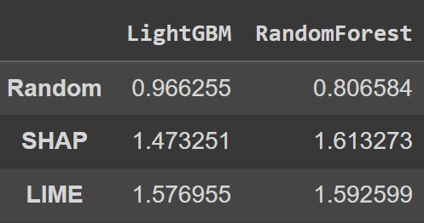
RESULTS AND CONCLUSION
Now that we have seen how the graphs are for the RF model, we can do the same procedure for the LGBT model.
And after this we find the MDMC value defined earlier, and tabulated them as such.
From this, it is observed that SHAP performs better for RandomForest while LIME performs better for LGBM.

Slide 17
References
Paper implemented in this project → "XAI Evaluation: Evaluating Black-Box ModelExplanations for Prediction"
Link → https://ieeexplore.ieee.org/document/9472817﻿
Dataset → https://archive.ics.uci.edu/ml/datasets/Iranian+Churn+Dataset
https://www.kaggle.com/datasets/royjafari/customer-churn
Documentation of Sklearn →https://scikit-learn.org/stable/﻿
Documentation of SHAP →https://shap.readthedocs.io/en/latest/index.html﻿
Documentation of LIME →https://lime-ml.readthedocs.io/en/latest/index.html﻿

Slide 18
CONTRIBUTION OF TEAM MEMBERS
Vishesh Kamani - Initial comparing of models and finding their metrics
Karthikeyan J - Working with SHAP framework, making the beeswarm plot and returning the most important features as a function
Kartik Sood - Implementing the LIME framework for local and global explanation for most important features.
Akash -Implementing the evaluation parameters for the different models along with creating graph and calculating the errors while taking out important features

